Slide 1


MOBILE APPLICATION DEVELOPMENT – BLOOD BANK
MADHAVI DURGA NALLURI-50550806
VENKATA SAITEJA NETHI-50569150

Slide 2

INTRODUCTION
Our project aim is to play a vital role in saving human life.
This project is developed so that users can view the information about the registered blood donors such as their names, address and personal information along with the blood groups and the health information of the donor.
Our project has a login page where the user must register and only then can they view the availability of blood. Users may also register to donate blood if the person wishes to do so.

Slide 3
Software Requirements
Java programming knowledge
Real time Database
Android smartphone
Firebase
Android Studio

Slide 4
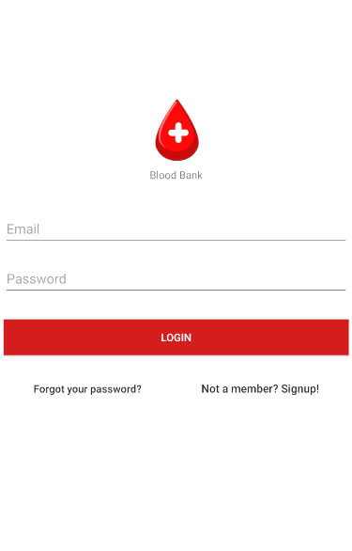
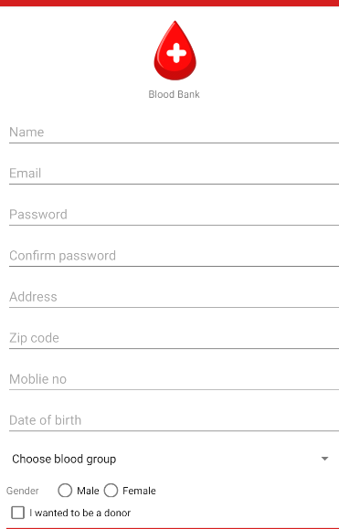
Working
User must register before entering the application.
Once the user is registered, he can enter the application.

Slide 5

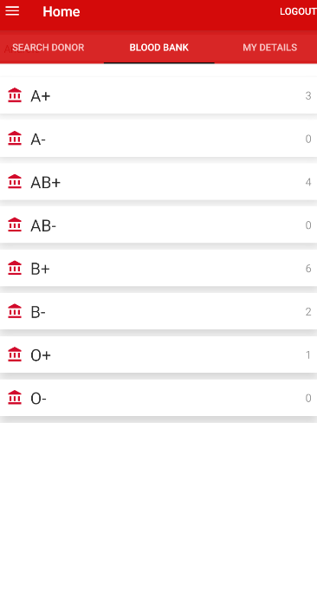
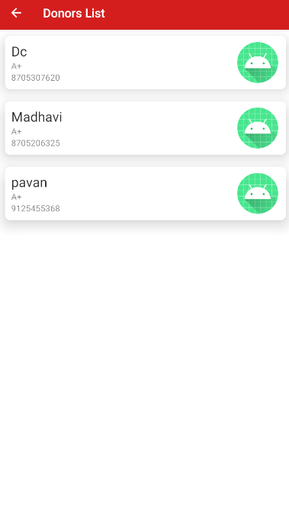
working
While registering the donor must submit all his details like blood group, Zip Code etc.,
With this Zip code the user can see the details of the list of available donors in the area and with the help of Blood Group the user is able to see the donors list.

Slide 6
Working
So, this application is used to select the right donor online instantly using the medical details with blood group which can save a life.
The main motto of this application is to reduce the time to a great extent that is required to spent in searching the right donor and the availability of the blood.
This application provides the required information in no time and also helps to make the quick decision making

Slide 7
Working
The first page will be the login page where he can access our application by signing in with the username and password which helps to keep track of the anonymous user.
If the user is using the application for the first time, they can register with the registration page where he/she can give provide details like name, age, address, gender and the blood group.
Once the user is logged in, he/she can get the information about the donor’s list of blood group in the Donor’s page.
If the user is searching for the number of blood units available in the blood bank, he/she can access that data in the blood bank page. If the user willing to be a donor or change his details he/she can do using the edit page.

Slide 8
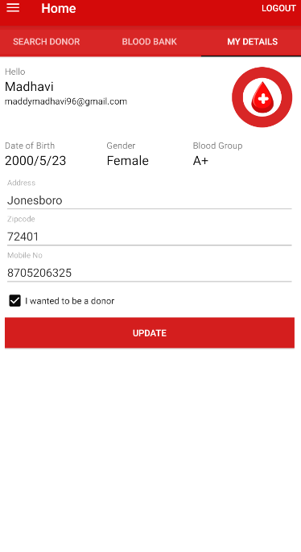
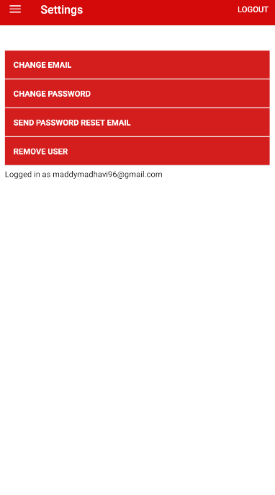
Donor Details and Updating
A user can see his entered details and change his details at any time and all details are store in backend database.

Slide 9
Database
A database is required to store entire details.
In our application we used the cloud store firebase.
The entire details are stored in a Json file.
The database is a real time storage where it stores all the data in real time.vv

Slide 10
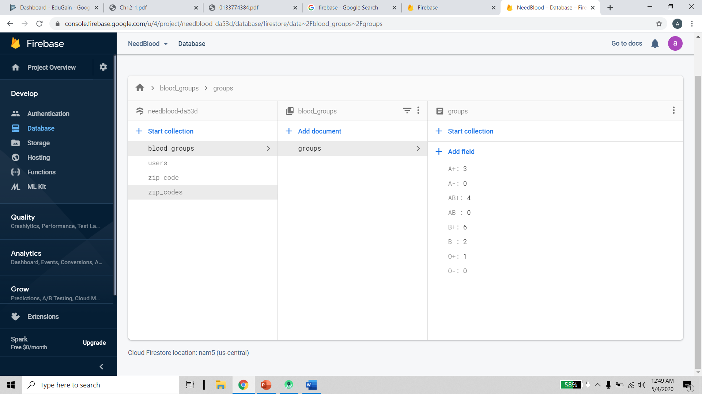
Database

Slide 11

Json file
A Json file is used to store data
A JSON file is a file that stores simple data structures and objects in JavaScript Object Notation (JSON) format, which is a standard data interchange format. It is primarily used for transmitting data between an application and a server.
With the help of firebase there is no need of creating any back-end code.

Slide 12
Xml Manifest File
The manifest file describes essential information about the app to the Android build tools, the Android operating system, and Google Play.
The components of the app, which include all activities, services, broadcast receivers, and content providers. Each component must define basic properties such as the name of its Java class.
The manifest file is also where you can declare what types of hardware or software features your app requires, and thus, which types of devices your app is compatible with

Slide 13
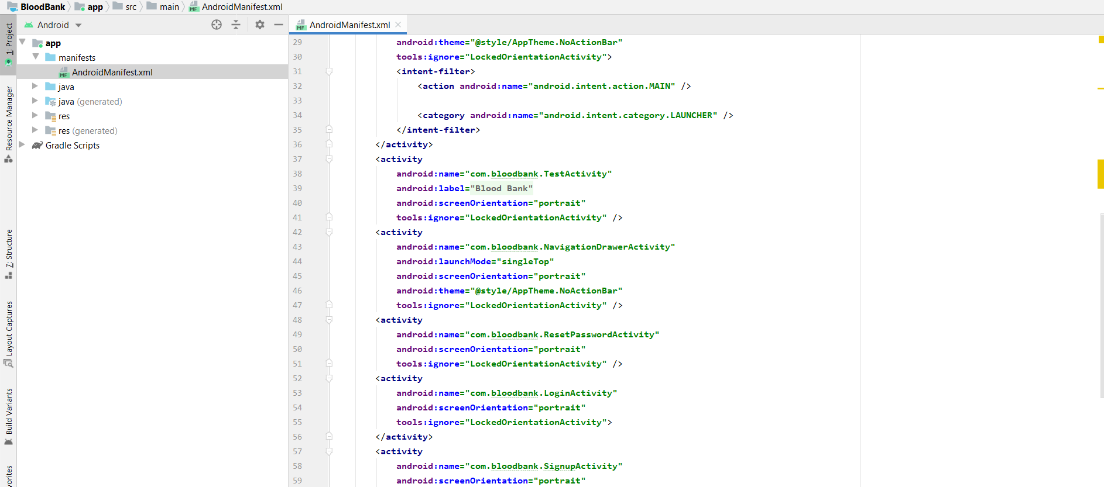
Blood Bank Manifest File

Slide 14

Monitoring Data
A regular monitoring of app can be done through firebase.
The monitoring features include
How many users are using the app.
How many donors are available in particular city.
App Crashes.
App functionality.
App response time in user activity.

Slide 15

Loss of data
There is no loss of data since the entire data is store in cloud firestore.
The security threat is also not a problem since all users must register before they login.
Only the registered users can access the application.
The registered users can be tracked through firebase and their entry logs.

Slide 16
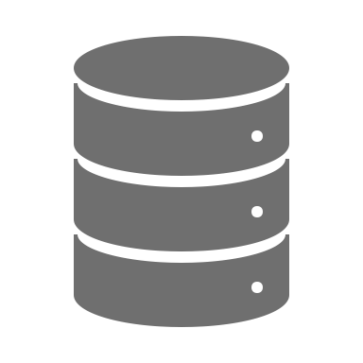
Building apk
Once the application is successfully built then there are two variants of APK which are
Release
Debug
For generating in Release select build variant as Release in Android Studio Build menu.
For generating in debug mode select build variant as debug in Android Studio Build menu.
In order to publish the app in google play console for beta versions the APK must be built in release mode.

Slide 17
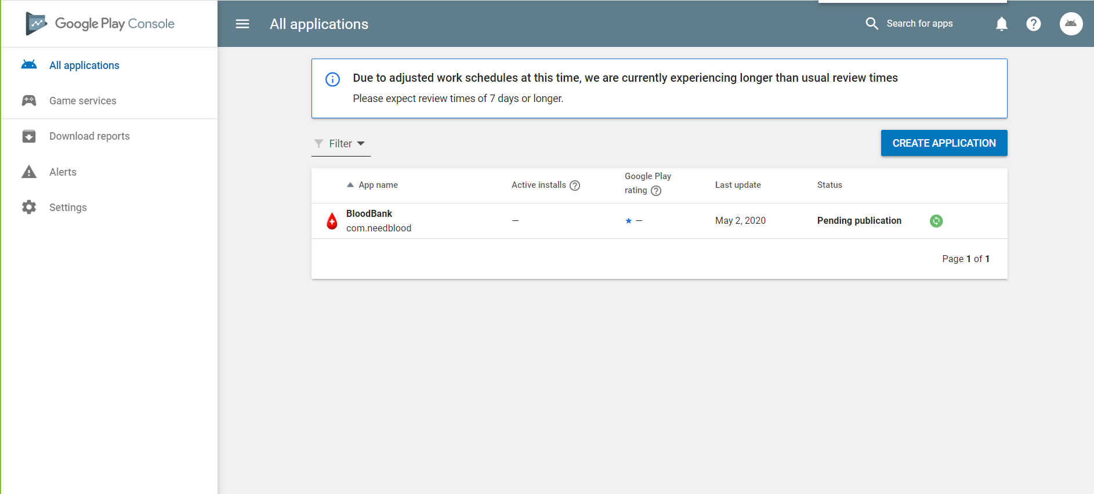
Google play console

Slide 18

Thank you

